Slide 1
Exploratory Data Analysis and Machine Learning on California Housing Prices
May 2025
Presented by
Durgasi, Ranjitha
Ettam, Harshitha
Korapati Murali, Harshitha
Mengane, Dhawalshree Ashok
Nallanagula, Nikhitha Reddy
Company Name
Quarter Month
Year

Slide 2
Content
1
Introduction & Abstract
2
Dataset & Preprocessing
3
Exploratory Data Analysis (EDA)
4
Machine Learning Models
5
Results & Evaluation
6
Conclusion & Future Work
Company Name
Quarter Month
Year

Slide 3



This project presents an Exploratory Data Analysis (EDA) and Machine Learning (ML) approach to California housing data.
Our objective is to uncover patterns and predict housing prices based on demographic and geographic features.
The study uses supervised learning models to identify the most influential factors affecting house values.
The insights can support stakeholders like realtors, policymakers, and homebuyers in making informed decisions.
Abstract

Slide 4
The California Housing dataset, derived from the 1990 Census, includes housing and population data across various districts.
The primary aim is to explore the data, understand feature relationships, and predict the median house value.
Machine Learning models such as Linear Regression, Decision Trees, and Random Forests are employed to enhance analytical depth.
Classification is also performed to categorize houses into value groups (Low, Medium, High), aiding better market segmentation.
Introduction

Slide 5
Source: Provided as housing.csv – based on California census blocks.
Attributes:
Numerical: median_income, housing_median_age, total_rooms, population, etc.
Categorical: ocean_proximity – indicates distance from the ocean.
Target Variable: median_house_value – used for regression and classification tasks.
Summary:
No major data-type inconsistencies.
Descriptive stats show varying income levels and house values across regions.
Dataset Description

Slide 6
Missing Values: Rows with missing entries (mainly total_bedrooms) were removed to maintain data integrity.
Categorical Encoding:
ocean_proximity was converted into dummy variables using one-hot encoding.
This avoids introducing bias from ordinal assumptions.
Feature Scaling:
StandardScaler was applied to normalize numerical features.
This ensures uniformity in scale, especially important for distance-based algorithms and gradient-based optimization.
Data Preprocessing

Slide 7
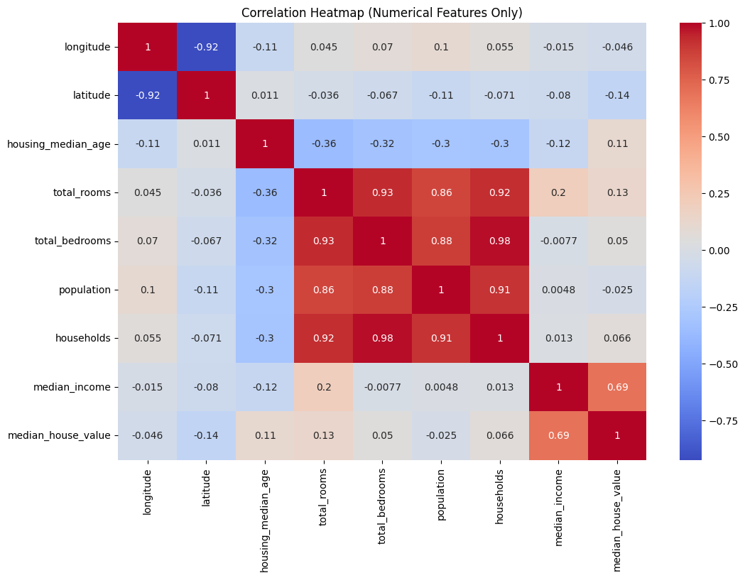
Correlation Heatmap
Company Name
Quarter Month
Year

Slide 8
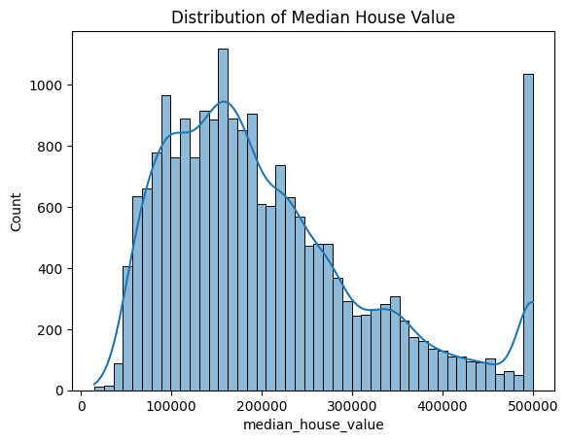
Target Variable Distribution
Company Name
Quarter Month
Year

Slide 9
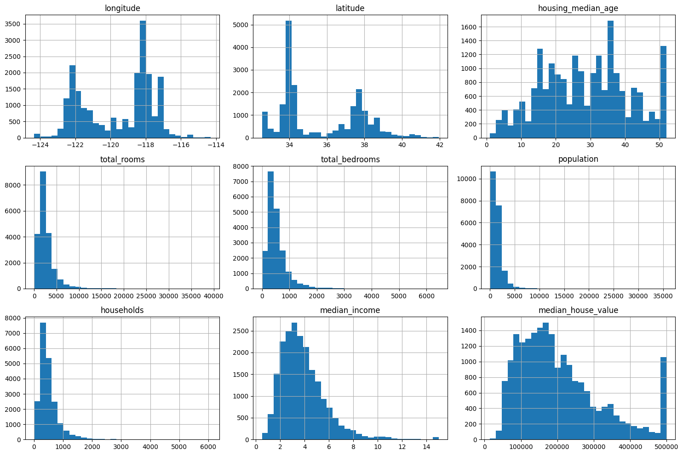
Histogram of All Features
Company Name
Quarter Month
Year

Slide 10
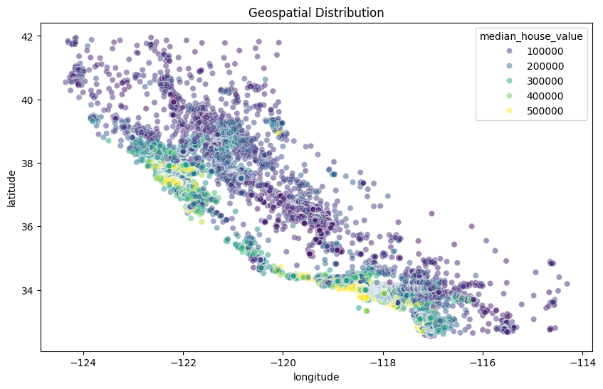
Geospatial Scatter Plot
Company Name
Quarter Month
Year

Slide 11
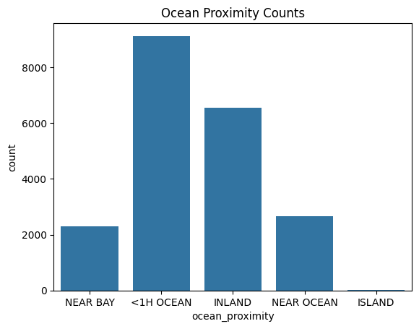
Ocean Proximity Counts
Company Name
Quarter Month
Year

Slide 12
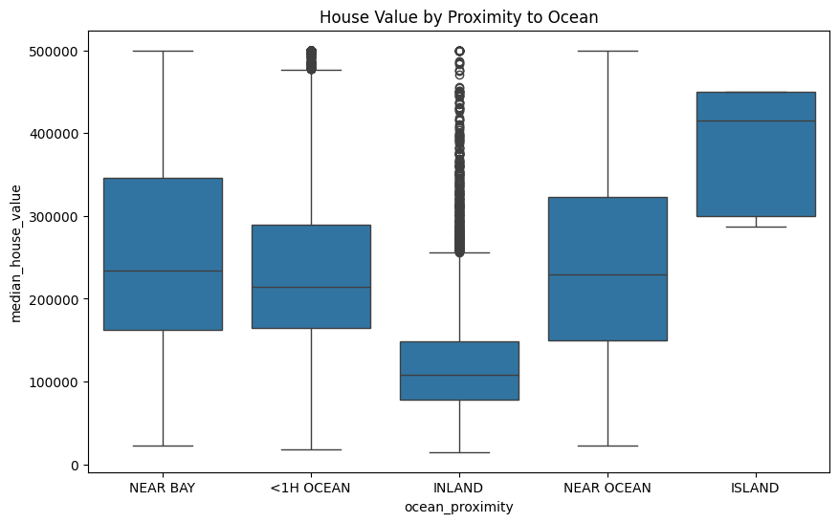
Boxplot by Ocean Proximity
Company Name
Quarter Month
Year

Slide 13
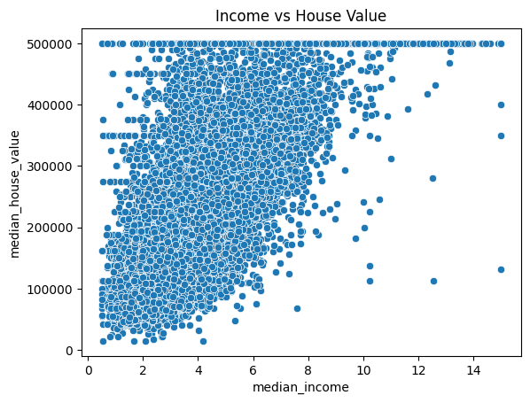
Income vs House Value Scatter Plot
Company Name
Quarter Month
Year

Slide 14
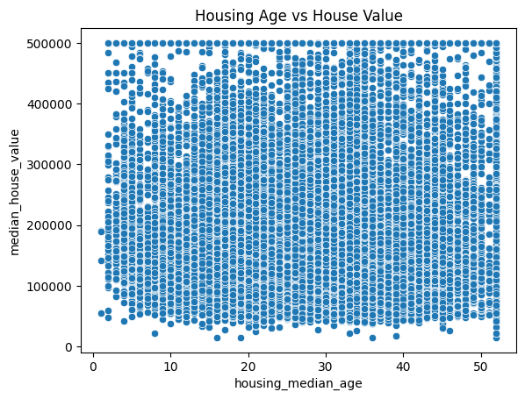
Housing Age vs House Value Scatter Plot
Company Name
Quarter Month
Year

Slide 15
Missing Value Check
Company Name
Quarter Month
Year

Slide 16

Literature Review
Previous Work: The California Housing dataset is widely used in academic and industrial settings for housing price prediction.
Studies show that median_income is the strongest predictor of median_house_value.
Common references include Kaggle kernels, Scikit-learn tutorials, and research papers on socioeconomic housing analysis.
Modeling Strategies:
Linear models are useful for establishing performance baselines.
Decision Trees and Random Forests are preferred for capturing complex, nonlinear interactions.
Classification approaches are used when converting price prediction into value segmentation (e.g., Low, Medium, High).
Company Name
Quarter Month
Year

Slide 17
Methodology / Architecture
Regression Models:
Linear Regression: Fits a straight line; interpretable but limited in handling complex patterns.
Decision Tree Regressor: Splits data into regions to model nonlinearity; can overfit on small data.
Random Forest Regressor: Aggregates multiple decision trees to reduce overfitting and improve accuracy.
Company Name
Quarter Month
Year

Slide 18
Methodology / Architecture
Classification Models:
Logistic Regression: Probabilistic linear model used to classify houses into value categories.
Decision Tree Classifier: Makes decisions by creating a tree-like structure based on feature values.
Random Forest Classifier: Uses an ensemble of decision trees for better generalization.
Company Name
Quarter Month
Year

Slide 19
Methodology / Architecture
Train-Test Splitting & Evaluation:
Used 80/20 train-test split to evaluate models.
Applied StandardScaler to normalize numerical features.
Metrics:
Regression: R² Score and scatter plots of actual vs. predicted.
Classification: Accuracy, precision, recall, F1-score via classification reports.
Company Name
Quarter Month
Year

Slide 20
Results & Model Evaluation
Regression Model Performance (R² Score)
Model | R² Score
Linear Regression | 0.6488
Decision Tree Regressor | 0.7219
Random Forest Regressor | 0.7860 ⭐ (Best)
Insight: Random Forest outperforms others in capturing complex feature interactions.
Company Name
Quarter Month
Year

Slide 21
Results & Model Evaluation
Classification Model Performance (Accuracy & F1 Score)
Model | Accuracy | Weighted Avg F1 Score
Logistic Regression | 75% | 0.75
Decision Tree Classifier | 79% | 0.79
Random Forest Classifier | 80% | 0.79 ⭐ (Most balanced)
Class-wise Insight:
High value homes: Precision highest in Random Forest (91%)
Medium value homes: Best recall in Random Forest (87%)
Low value homes: Consistently high across all models
Company Name
Quarter Month
Year

Slide 22
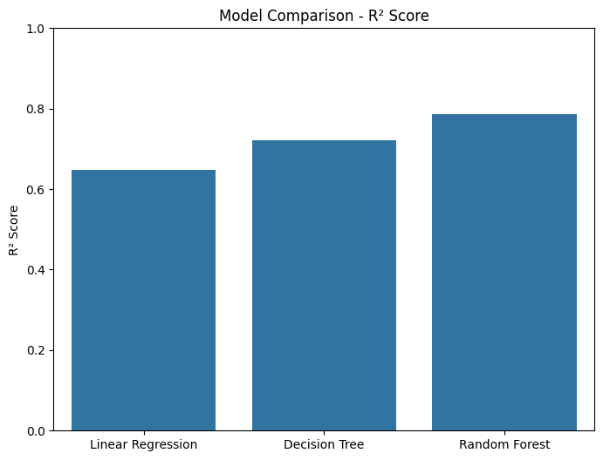
Results & Model Evaluation
Model R² comparison
Company Name
Quarter Month
Year

Slide 23
Conclusion
Key Findings:
Median_income is the strongest predictor of house value.
Models capture nonlinearities better than linear approaches.
Random Forest performed best across both regression and classification tasks.
Limitations:
Dataset only covers California and may not generalize.
No feature for real-time or temporal housing trends.
Company Name
Quarter Month
Year

Slide 24
Recommendations & Future Work
Improvement Suggestions:
Include temporal variables like year of sale or economic indicators
Use ensemble stacking or XGBoost for potentially higher accuracy
Future Work:
Explore deep learning methods (e.g., neural networks)
Combine with geospatial or map-based APIs for location intelligence
Company Name
Quarter Month
Year

Slide 25
References
Dataset
Nugent, C. (2017). California Housing Prices Dataset. Retrieved from https://www.kaggle.com/datasets/camnugent/california-housing-prices (File used: housing.csv, based on the 1990 California Census)
Libraries and Tools
Pandas – Data manipulation and analysis
NumPy – Numerical computations
Matplotlib and Seaborn – Data visualization
Scikit-learn – Machine learning models and preprocessing
Google Colab – Cloud-based Python execution environment
Documentation and Resources
Scikit-learn Official Documentation: https://scikit-learn.org
Kaggle Notebooks related to California Housing Price predictions
Research papers and blogs on housing value modeling and regression/classification techniques
Company Name
Quarter Month
Year

Slide 26
GitHub
https://github.com/rd39257n/Python-Final

